Slide 1
Base Conversion
Between Powers of 2: 2, 8, 16 Examples: Rechunk
Convert each digit to binary: Lookup Table or from memory!
Merge then rechunk the bits
Convert each chunk to the appropriate digit
Base N to 10
Use Expanded Notation, or
For each digit: multiply by N, and then add the value of the digit
Base 10 to Base N
Successively divide the number by N
The concatenation of the remainders produce the final value
Consider the examples via the spreadsheet: Base Conversion

Slide 2
Base N to Base 10
16# 5a2
Algorithm: multiply, add, and shift
set v = 0
For each digit (from left to right)
v = v * base; # Multiple by the base
v = v + digit₁₀; # Add the next digit
print v
Consider: 16# 5a2 == 1442
v: | 5 | = | 0 | * 16 + | 5 | 5
v: | 90 | = | 5 | * 16 + | 10 | a
v: | 1442 | = | 90 | * 16 + | 2 | 2
=
*
N
+

Slide 3
Base N to Base 10
2# 10110101
Algorithm: multiply, add, and shift
set v = 0
For each digit (from left to right)
v = v * base; # Multiple by the base
v = v + digit₁₀; # Add the next digit
print v
Consider: 2# 10110101 == 181
v: | 1 | = | 0 | * 2 + | 1 | 1
v: | 2 | = | 1 | * 2 + | 0 | 0
v: | 5 | = | 2 | * 2 + | 1 | 1
 | 11 | = | 5 | * 2 + | 1 | 1
 | 22 | = | 11 | * 2 + | 0 | 0
 | 45 | = | 22 | * 2 + | 1 | 1
 | 90 | = | 45 | * 2 + | 0 | 0
 | 181 | = | 90 | * 2 + | 1 | 1
=
*
N
+

Slide 4
Base N to Base 10
?8# 453
Algorithm: multiply, add, and shift
set v = 0
For each digit (from left to right)
v = v * base; # Multiple by the base
v = v + digit₁₀; # Add the next digit
print v
Consider: 8# == ?
v: | 4 | = | 0 | * 8 + | 4 | 4
v: | 37 | = | 4 | * 8 + | 5 | 5
v: | 299 | = | 37 | * 8 + | 3 | 3
=
*
N
+

Slide 5
Base Conversion of Real Numbers
Base 10 to Base N
The whole portion is divided by the new base, repeatedly
Dividend / Divisor = (Quotient, Remainder)
The concatenation of the Remainders provide you with the final digits
The fraction portion is multiplied by the new base, repeatedly
Multiplier * Multiplicant = (Overflow, Product)
The concatenation of the Overflows provide you with the final digits
Consider the examples via the spreadsheet: Base Conversion

Slide 6
Decimal Real to Binary Real
Split the number at the radix point: whole . fractional
Put the two pieces together
With the whole part,
number = whole while (number != 0 ){ number = number / 2 push ( number % 2 ) } pop_all();
With the fractional part
max = 10 ** stringlength(fractional) number = fractional while (number != 0 ) { number = number * 2 if ( number > max ) { emit 1 number = number - max } else { emit 0 } }

Slide 7
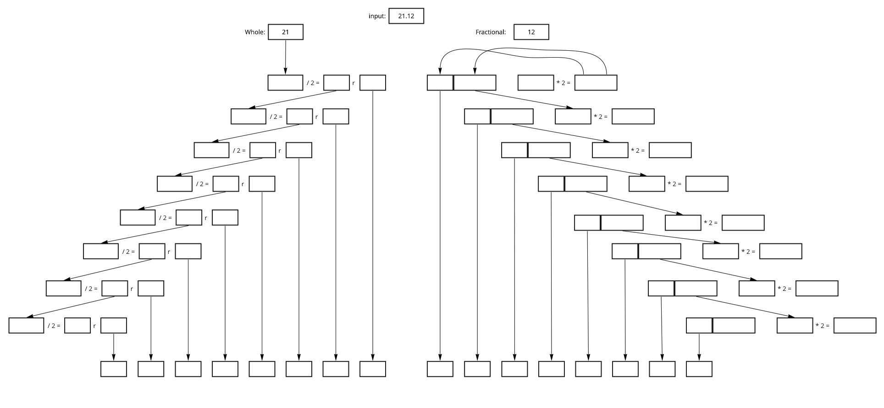
Real: Decimal to Binary

Slide 8
Example: - 39.234 Whole Part
Split the number at the radix point: - 39 . fractional
Put the two pieces together
With the whole part,
number = whole while (number != 0 ){ number = number / 2 push ( number % 2 ) } pop_all();
number: 39 number = 39 / 2 → 19 push ( 39 % 2 ) → 1 number = 19 / 2 → 9 push( 19 % 2) → 1 number = 9 / 2 → 4 push( 9 % 2) → 1 number = 4 /2 → 2 push( 4 % 2) → 0 number = 2 / 2 → 1 push ( 2 % 2 ) → 0
number = 1 / 2 → 0 push ( 1 % 2 ) → 1
100111
-
100111
.

Slide 9
Example: - 39.234 Fractional Part
Split the number at the radix point: whole . 234
Put the two pieces together
max = 10 ** |234| == 1,000 number = 234 number = 234 * 2 = 0,468 number = 468 * 2 = 0,936 number = 936 * 2 = 1,872 - 1000 = 872 number = 872 * 2 = 1,744 - 1000 = 744 number = 744 * 2 = 1,488 - 1000 = 488 number = 488 * 2 = 0,976 number = 976 * 2 = 1,952 - 1000 = 952
With the fractional part
max = 10 ** stringlength(fractional) number = fractional while (number != 0 ) { number = number * 2 if ( number > max ) { emit 1 number = number - max } else { emit 0 } }
.
0011101

Slide 10
Example: - 39.234 Both Parts
Split the number at the radix point: whole . fractional
Put the two pieces together
With the whole part,
number = whole while (number != 0 ){ number = number / 2 push ( number % 2 ) } pop_all();
With the fractional part
max = 10 ** stringlength(fractional) number = fractional while (number != 0 ) { number = number * 2 if ( number > max ) { emit 1 number = number - max } else { emit 0 } }
-
100111
.
0011101

Slide 11
Example: 45.45 Whole Part
Split the number at the radix point: whole . fractional
Put the two pieces together
With the whole part,
number = whole while (number != 0 ){ number = number / 2 push ( number % 2 ) } pop_all();
number: 45 number = 45 / 2 → 22 push ( 45 % 2 ) → 1 number = 22 / 2 → 11 push ( 22 % 2 ) → 0 number = 11 / 2 → 5 push ( 11 % 2 ) → 1 number = 5 / 2 → 2 push ( 5 % 2 ) → 1 number = 2 / 2 → 1 push ( 2 % 2 ) → 0 number = 1 / 2 → 0 push ( 1 % 2 ) → 1 number = 0 / 0
101101
101101
.

Slide 12
Example: 45.45 Fractional Part
Split the number at the radix point: whole . 45
Put the two pieces together
max = 10 ** |45| == 100 number = 45 number = number * 2 = 90 number = number * 2 = 180 - 100 = 80 number = 80 * 2 = 160 - 100 = 60 number = 60 * 2 = 120 - 100 = 20 number = 20 * 2 = 40 number = 40 * 2 = 80 number = 80 * 2 = 160 = 100 = 60
With the fractional part
max = 10 ** stringlength(fractional) number = fractional while (number != 0 ) { number = number * 2 if ( number > max ) { emit 1 number = number - max } else { emit 0 } }
.
0111001

Slide 13
Example: 45.45
Split the number at the radix point: whole . fractional
Put the two pieces together
With the whole part,
number = whole while (number != 0 ){ number = number / 2 push ( number % 2 ) } pop_all();
With the fractional part
max = 10 ** ( | fractional | ) fractional = number while (number != 0 ) { number = number * 2 if ( number > max ) { emit 1 number = number - max } else { emit 0 } }
101101
.
0111001

Slide 14
Example: Whole Part
Split the number at the radix point: ? . fractional
Put the two pieces together
With the whole part,
number = whole while (number != 0 ){ number = number / 2 push ( number % 2 ) } pop_all();
number: number = / 2 → push ( % 2 ) → 1

Slide 15
Example: Fractional Part
Split the number at the radix point: whole . ?
Put the two pieces together
max = 10 ** |?| == number = ? number = number * 2 =
With the fractional part
max = 10 ** stringlength(fractional) number = fractional while (number != 0 ) { number = number * 2 if ( number > max ) { emit 1 number = number - max } else { emit 0 } }
.

Slide 16
Example:
Split the number at the radix point: whole . fractional
Put the two pieces together
With the whole part,
number = whole while (number != 0 ){ number = number / 2 push ( number % 2 ) } pop_all();
With the fractional part
max = 10 ** ( | fractional | ) fractional = number while (number != 0 ) { number = number * 2 if ( number > max ) { emit 1 number = number - max } else { emit 0 } }
.

